Slide 1


REGRESSION FOR MACHINE LEARNING
Presentation bY – Saurabh Kolhe and rohit shaw

Slide 2
CONTENTS
Basic Terminologies
Regression-Definition
Types of Regression
Linear Regression
Logistic Regression
Error Analysis

Slide 3
Dependent and independent variables
Independent variables are regarded as input to system and may take on different values freely. It is also called as predictor, denoted by X.
Dependent variables are those which change as a consequence of change in other variables. It is also known as response variable, denoted by Y.

Slide 4

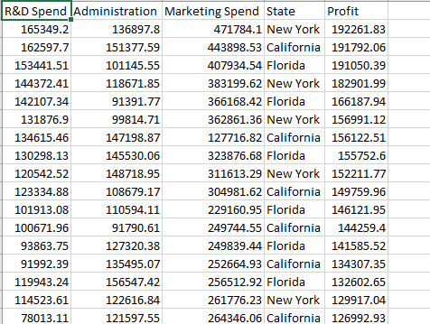
Dataset showing profit trends of an org.
Determine dependent and independent variables.

Slide 5
Hyperparameter, Epoch and learning rate
In machine learning, a hyperparameter is a parameter whose value is set before the learning process begins.
The number of epochs is a hyperparameter that defines the number times that the learning algorithm will work through the entire training dataset.
The learning rate or step size in machine learning is a hyperparameter which determines to what extent newly acquired information overrides old information.

Slide 6
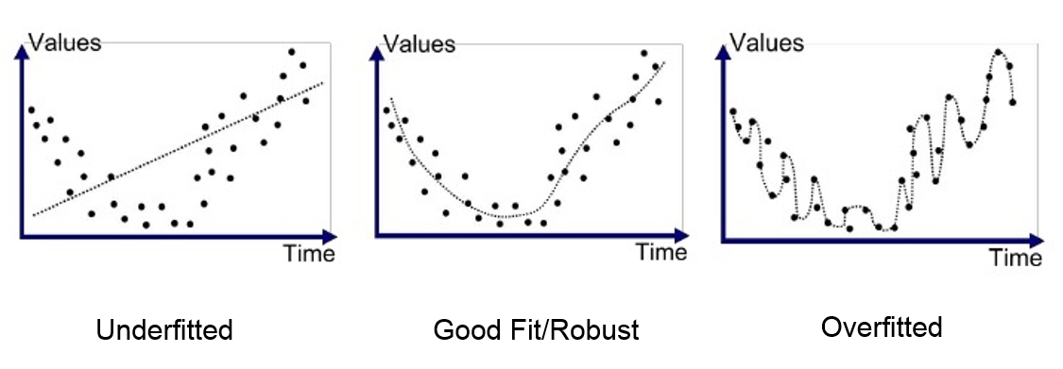
UNDERFITTING AND OVERFITTING

Slide 7
Example of overfitting
Copyright Nvidia DLI

Slide 8
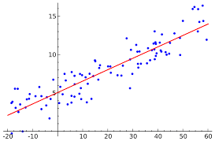
WHAT IS REGRESSION ?
It is a statistical measure that attempts to determine the strength of the relationship between one dependent variable(Y) and other changing independent variables(X).
It is widely used for prediction and forecasting.

Slide 9
Types of regression
LINEAR REGRESSION – Univariate and Multivariate
POLYNOMIAL REGRESSION – Univariate and Multivariate
LOGISTIC REGRESSION – Univariate and Multivariate

Slide 10
LINEAR REGRESSION
In statistics, linear regression is a linear approach to modeling the relationship between a scalar response (or dependent variable) and one or more explanatory variables (or independent variables).

Slide 11
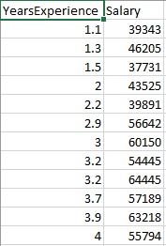
UNIVARIATE Linear REGRESSION
A model consisting of one independent and one dependent variable.
Equation:
y = mx + c

Slide 12
Multivariate Linear regression
A model consisting of more than one independent variables.
Equation:
y = m₁x₁ + m₂x₂ +m₃x₃…. + c

Slide 13
Real world examples
Linear Regression is a rather ubiquitous curve fitting and machine learning technique that’s used everywhere from scientific research teams to stock markets.
Studying engine performance from test data in automobiles
Least squares regression is used to model causal relationships between parameters in biological systems
OLS regression can be used in weather data analysis
Linear regression can be used in market research studies and customer survey results analysis

Slide 14
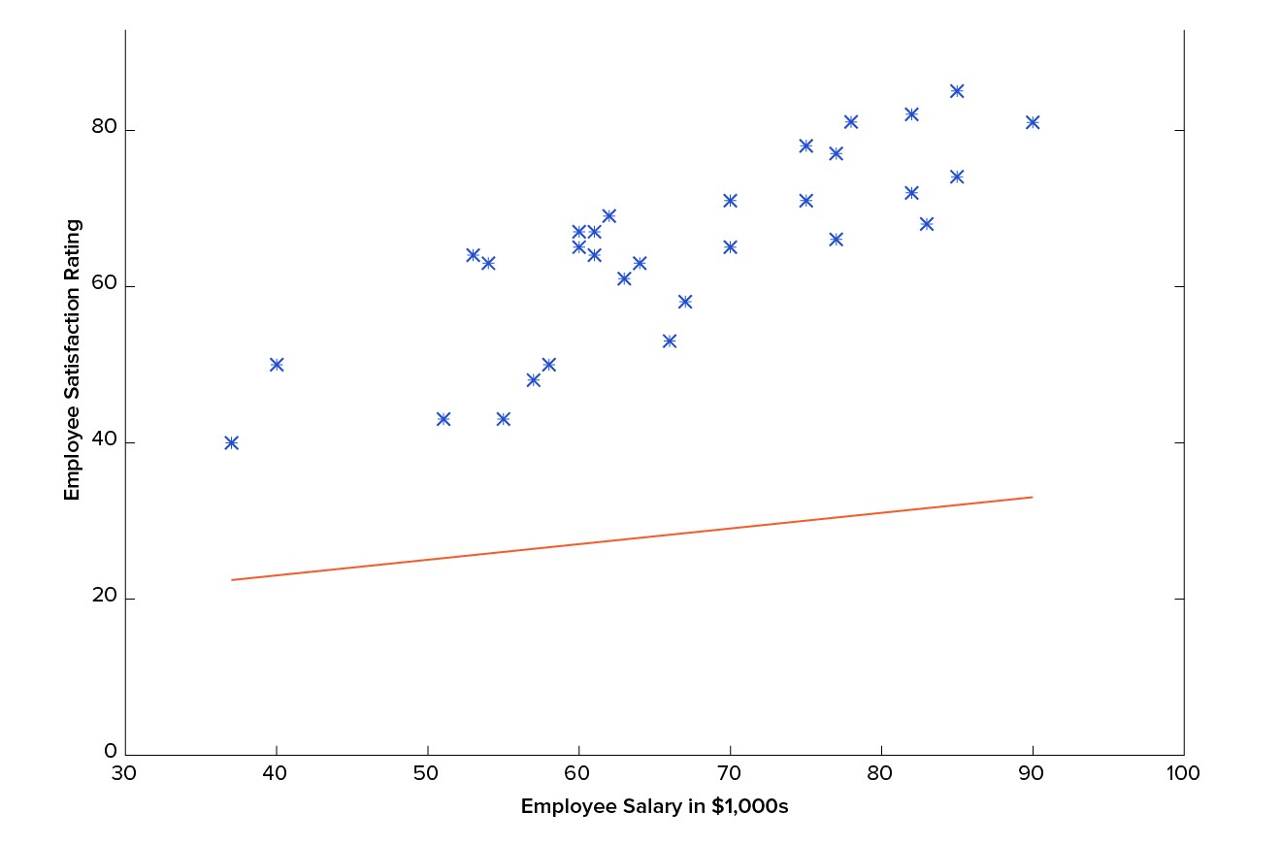
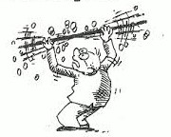
HOW TO FIND VALUES OF PARAMETERS ?

Slide 15
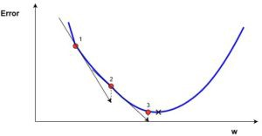
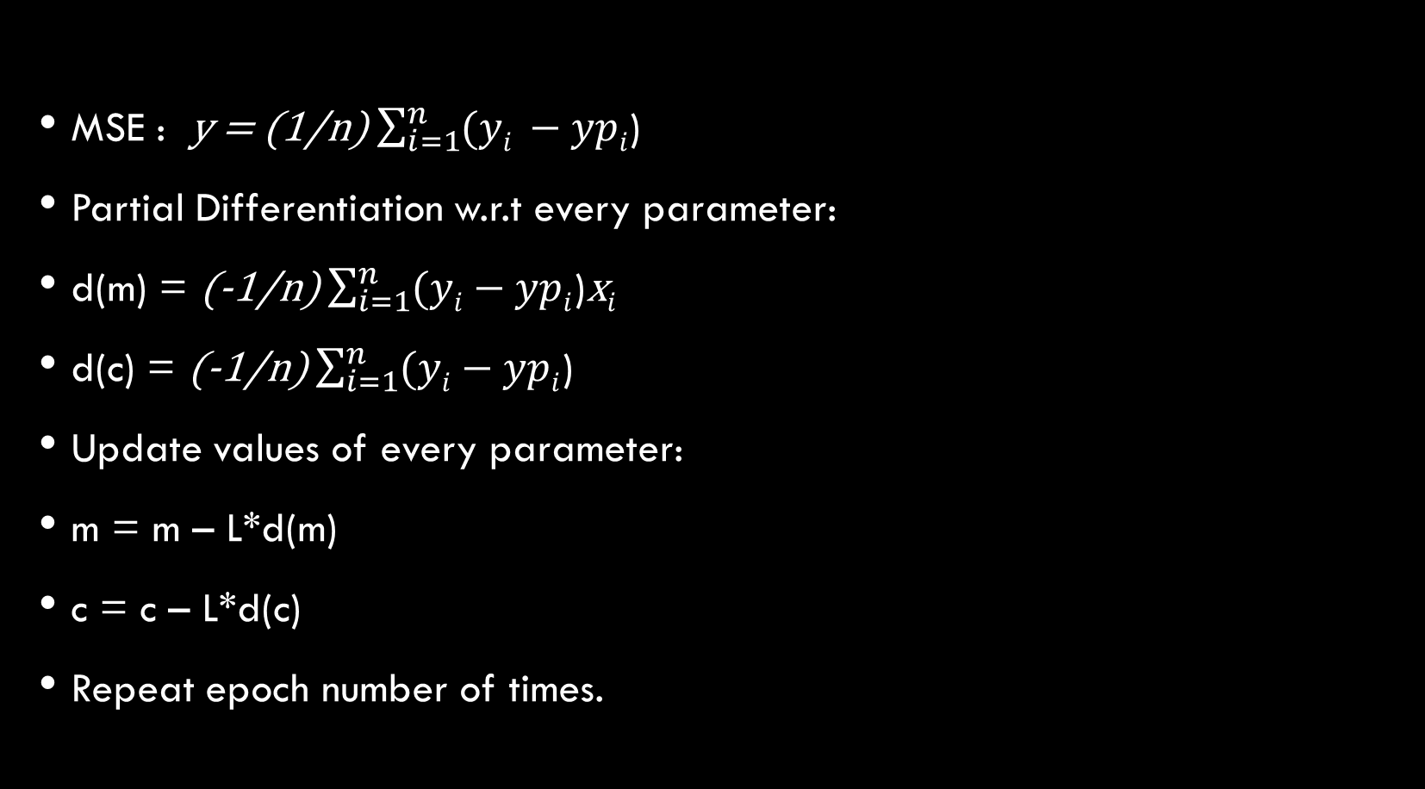
Gradient descent
MSE : y = (1/n) $\sum_{i=1}^{n}{(yi }−ypi$)
Partial Differentiation w.r.t every parameter:
d(m) = (-1/n) $\sum_{i=1}^{n}{(yi}−ypi$)x$i$
d(c) = (-1/n) $\sum_{i=1}^{n}{(yi}−ypi$)
Update values of every parameter:
m = m – L*d(m)
c = c – L*d(c)
Repeat epoch number of times.

Slide 16
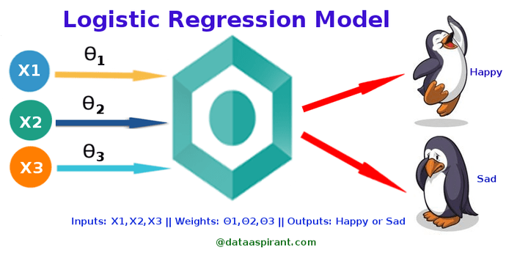
Logistic REGRESSION
Logistic regression is a statistical method for analyzing a dataset in which there are one or more independent variables that determine an outcome. The outcome is measured with a dichotomous variable (in which there are only two possible outcomes).

Slide 17
Real world examples
Spam Detection : Predicting if an email is Spam or not
Credit Card Fraud : Predicting if a given credit card transaction is fraud or not
Health : Predicting if a given mass of tissue is benign or malignant
Marketing : Predicting if a given user will buy an insurance product or not
Banking : Predicting if a customer will default on a loan.

Slide 18
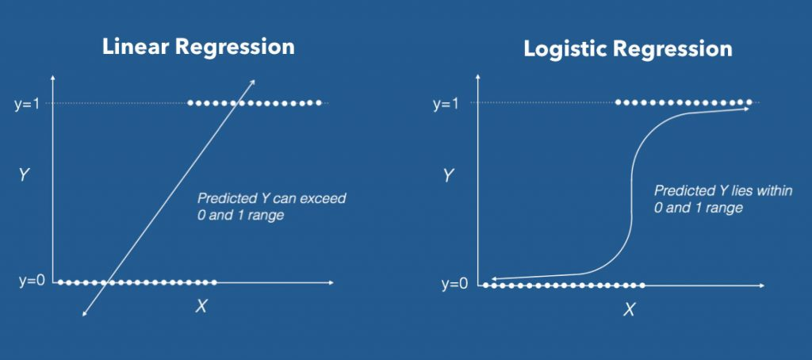
Why not linear regression

Slide 19
Types of logistic regression
Binary Logistic Regression - has only two 2 possible outcomes
Multinomial Logistic Regression - Three or more categories without ordering.
Ordinal Logistic Regression - Three or more categories with ordering

Slide 20
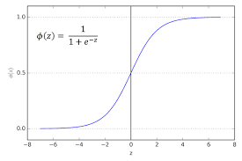
logistic function

Slide 21
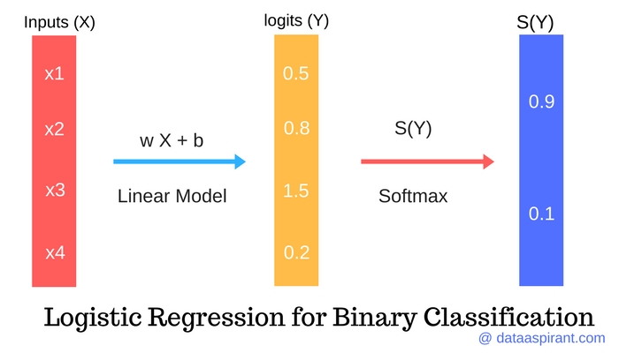
logistic function

Slide 22
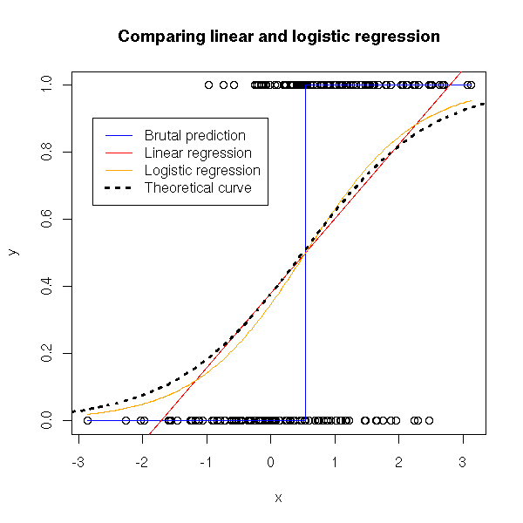
logistic function

Slide 23

Cost function
Binary Cross-Entropy / Log Loss Function

Slide 24
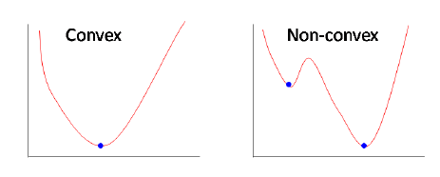
Why different cost function?

